Slide 1

Stat 184 Final Presentation
By: Xinyi Bao, Kaitlyn Klumb, and Samuel Quinn

Slide 2

Research Question
Where are Youtuber channels most popular in the world, and does their internet speed play a role?
Our Hypothesis: Internet speed may play a significant role in making the YouTube channels popular in the world.

Slide 3

Challenge Encountered
Conflicts with GitHub Desktop to collaborate on the code
We did our work on our local laptops, edited the main code on GitHub, and committed the changes.
Increase our efficiency
Notes:
We tried using GitHub Desktop to collaborate on the code but had trouble pulling and pushing the R markdown file. So, we went back to the online version.
We did our work on our local laptops and then edited the main code on GitHub and committed the changed. It made it more efficient in putting the code together.

Slide 4
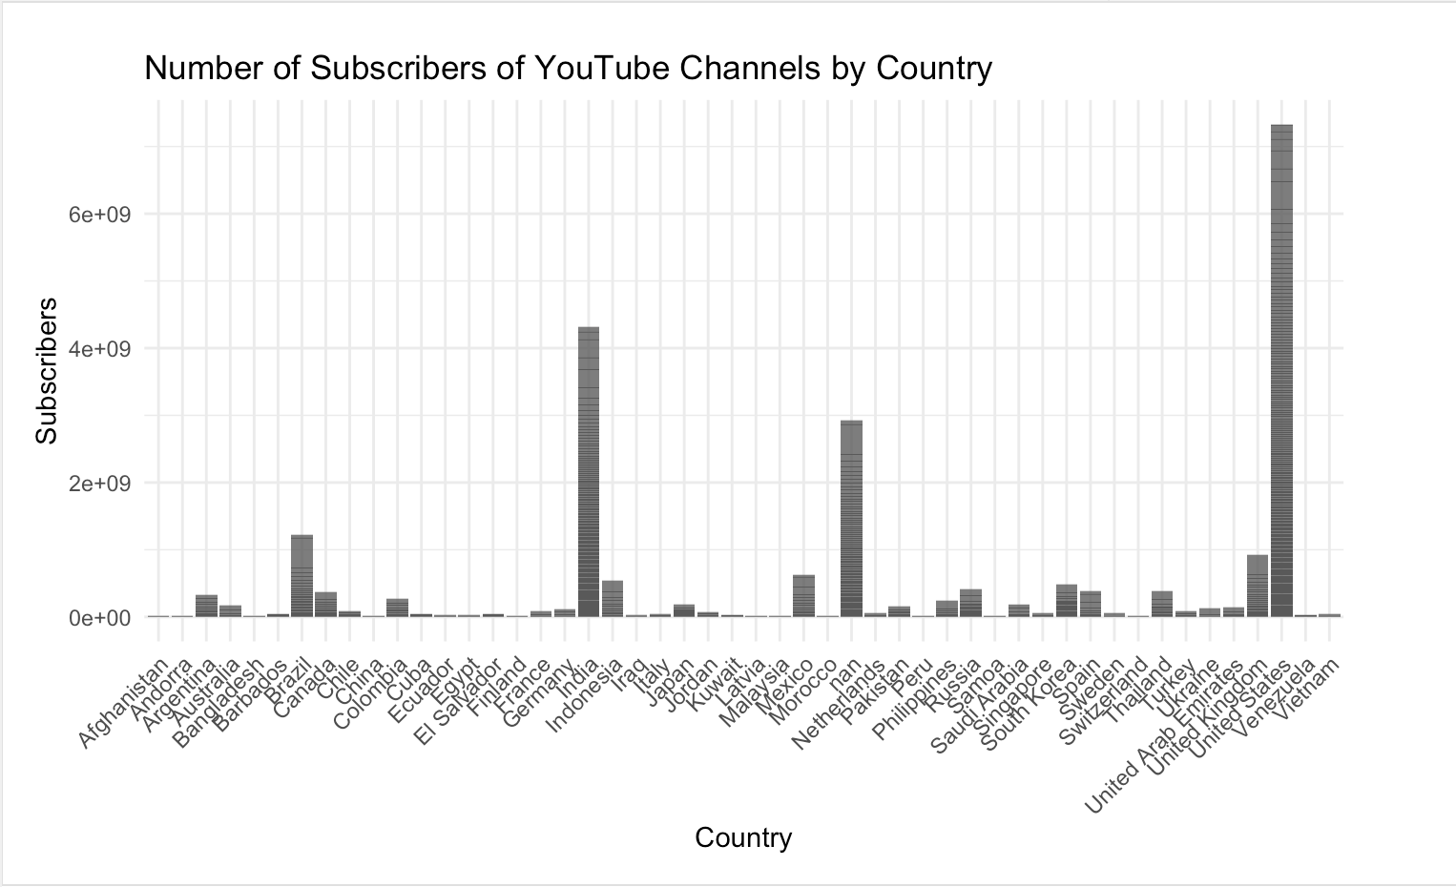
Graph for Global Youtuber

Slide 5
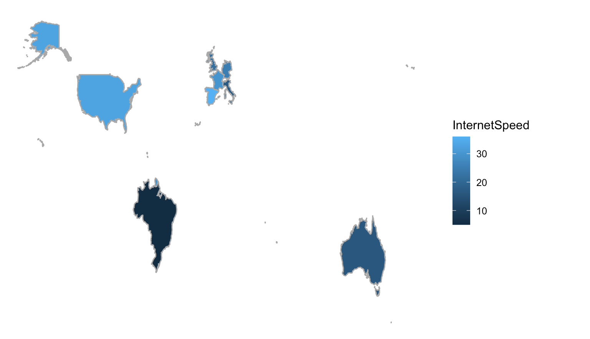
Graph for Global Internet Speed 2019

Slide 6
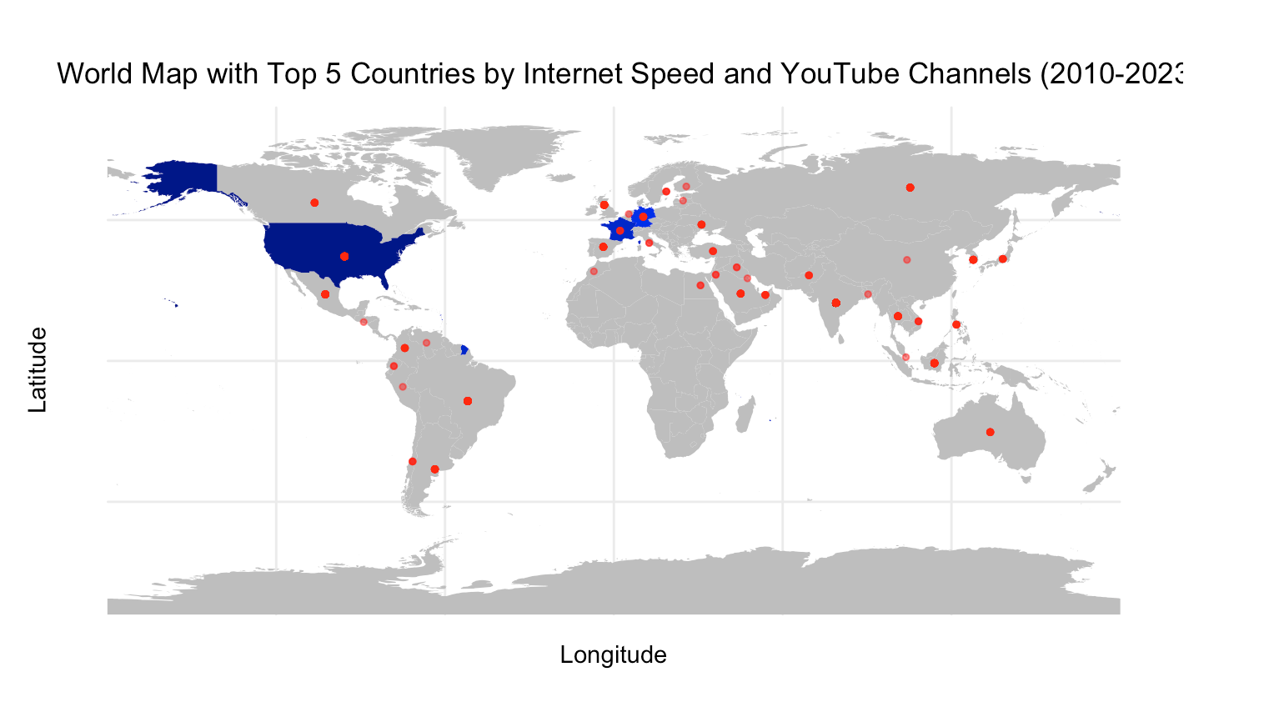
Key Visualization

Slide 7
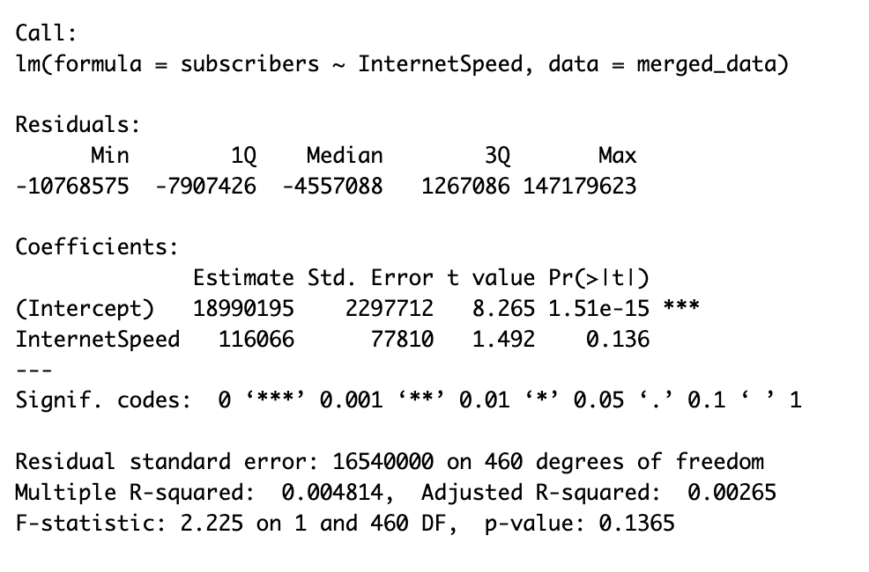
Linear Regression

Slide 8

Conclusion
For the first question: United States, Spain, Germany, France
For the second question: There is no significant linear relationship between Internet speed and the number of YouTube subscribers.

